Slide 1
Challenges in IPO Issue in Indian Market

Slide 2

HELLO!
Group - 7
Siddhant Shevale
Suhas Jain
Aniket Pravin Raut

Slide 3
“An IPO is like a negotiated transaction - the seller chooses when to come public and it’s unlikely to be the time that’s favourable to you.”
- Warren Buffett

Slide 4
Why a company goes public?
Raising capital for business
Creating liquidity for private equity investors | SBI Cards
Creating liquidity for employees | Avenue supermarts
Currency for Mergers & Acquisitions | Gruh Finance
For branding and visibility of the company | Reliance Retail / Jio

Slide 5
Challenges in the Indian IPO process
Underpricing or Overpricing by the underwriter
Corporate Governance requirements
Diversion of funds from secondary to primary market, causing liquidity loss in the secondary markets
Strict norms against foreign listings and foreign investments
Excessive speculation due to less number of genuine investors

Slide 6
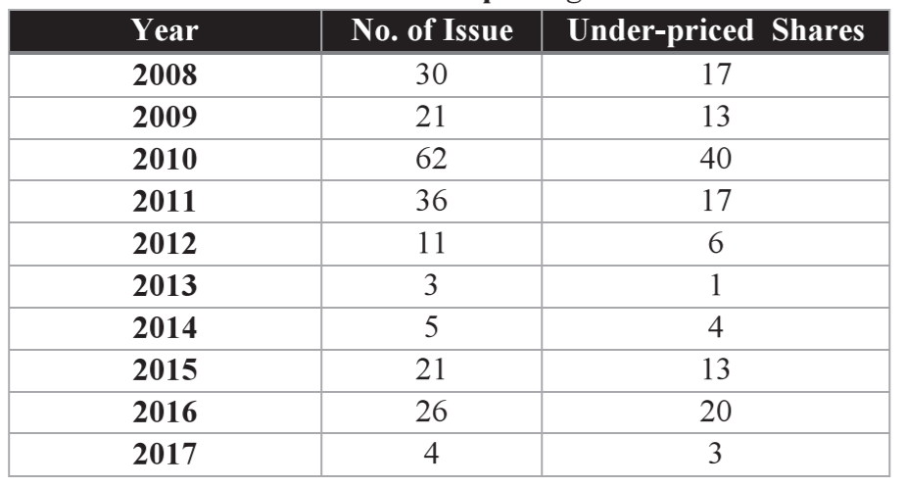
Underpricing of IPOs in India
When the offer price is lower than the first trade, then that stock is called or termed as under-priced. It leaves money on the table which is considered as a loss of capital from the point of view of the company.
Primary reasons:
Information asymmetry
Self-interests of Investment banks
Managerial conflicts
Behavioral explanations

Slide 7
Information Asymmetry
Self-interests of Investment Banks
This theory assumes IPO pricing is a product of information disparities.
Uninformed investors bid without any regard to the quality of the IPO.
Informed investors bid only on the offering they think will gain good returns.
The underwriters, however need uninformed investors because in India informed investors don’t exist in sufficient numbers.
To solve this problem, the underwriter reprices the IPO to bring in these investors and ensure that uninformed investors bid. The consequence is underpricing.
Investment banks underprice IPOs to protect their reputation. When new issues are priced lower than they should be, investment bankers reduce their legal liability by lowering the chance of price decline.
There is also evidence that greater underpricing leads to more aftermarket trading volume, which increases the revenue of investment bankers.
Investment banks do respond to appropriate incentives to reduce underpricing eg. higher underwriting fees, increased stake of underwriter in IPO through ownership of offered shares.

Slide 8
Managerial Conflicts
Behavioral Reasons
One of the main cause of underpricing is the self interest of the company management.
Many unlisted companies offer ESOPs to its employees. Under these type ESOPs schemes, RSUs are offered to the employees for the long-term association with the company in future ie. retention.
Management creates excess demand for the IPO shares to ensure that they can sell their holdings after the contractual period of lockup at a higher price.
Also because usually there are no large shareholders created by an underpriced IPO, making it more difficult to replace the top management of the company.
The efficient market hypothesis suggests that the price of an IPO is correct; however, both stock anticipation and investment sentiment contributes to first day stock jumps. Overreaction bias on anticipation of the new offering and the hype usually surrounding the IPO causes investors to over react.
Another explanation is to assume that firms underprice their IPOs to achieve higher stock valuations when they expect to conduct future seasoned secondary offerings.
Firms might also be encouraged to under price their shares by the underwriter if the investment bank holds long-term warrants to buy more shares from the firm (over-subscription provision) if excess demand is present

Slide 9
A small look into the IRCTC IPO
Rs. 110,00,00,00,000
Rs. 50,00,00,00,000
112
Indian railways was miffed over the pricing of the IRCTC NSE IPO that saw a overwhelming response and was listed at 101% premium.
IDBI capital markets, SBI capital markets and YES securities manages the issue.
The company lodged protest about the price at which the shares were offered to the investors and sought better due-diligence in the future.
Value of IRCTC at the end of day-1
Value of IRCTC at which the shares were issued
Times the IPO was oversubscribed

Slide 10
A small look into the IPO of Reliance power
73
19%
-17%
In January 2008, the maiden public issue of Reliance Power Limited was oversubscribed 73 times. It was the largest subscription of any IPO anywhere in the history of global capital markets with a record five million applicants. It became 10 top listed companies in India with the largest number of shareholders in any listed company in the world.
Reliance Power surged 19% to Rs 538 from the IPO price of Rs. 450. After that RPL dived to Rs355 and never returned even close to the issue price. By the close of the day, it was down 17% at Rs. 372 Four billion of its market capitalization wiped out in a single day.
In the following days, the nightmare worsened as another $5 billion of the market capitalization was lost.
Times the IPO was oversubscribed
Rise within the initial 4 minutes of trading
Closing price at the end of day-1

Slide 11
High Corporate Governance Requirements
Regulatory bodies in India require companies to have certain setups and infrastructure in place which are not explicitly required for a private company. Some of these may look like:
According to SEBI’s requirement of Corporate Governance as per their Clause 49 a board of directors and committees are required.
A small or midcap company operating well without a board of directors still is required to appoint one.
All the financial statements and cash flow statements need to be certified by a CEO/CFO.

Slide 12
An optimum number of executive and non executive with at least 50% non executive member.
If the chairman, has executive powers then 50% of Board comprises of Independent directors.
While if chairman has non-executive powers then 1/3 of the Board comprises of Independent directors
Audit Committee
Mandatorily constitutes three director and is headed by an independent director
Members should be financially literate and at least one should have accounting and management expertise.
Investor Committee
Formed under chairmanship of non executive director to look into redressing of shareholders and investor complaints like transfer of shares, non-receipt of balance sheet, non-receipt of declared dividends
Subsidiary Company
At Least one director on board should be on board of a material non listed Indian subsidiary company.
Audit committee of the listed holding company shall also review the financial statements, in particular, the investments by the unlisted subsidiary Company
Notes:
Material non-listed subsidiary means a subsidiary whose turnover or net worth exceeds 20% of the consolidated turnover or net worth in the preceding accounting year

Slide 13
Existence of these new setups and change in management structures of companies causes problems like:
Once a company’s stock is publicly listed, management decisions will tend to be biased based on the impact to near-term stock value. As a result, there may be tradeoffs that result in short-term gains at the expense of strategic investments and decisions.
Executive management and board directors are subject to greater liability when their stock is public, including class actions and derivative lawsuits regarding violations of securities or corporate laws.
Business opportunities that may have been available personally to the firm’s executives may now need to be turned over to the company.

Slide 14
Disclosure Requirement and Financial Reporting
The IPO implementation process and a listing on a reputed stock market are only possible when the company discloses the necessary financial information and provides periodic financial reporting of scope and quality substantially in excess of those required from a private company.
For example, a public company must disclose the names of its ultimate beneficiaries, provide detailed information about the financial position and development plans, disclose remuneration of the directors, and other relevant information.
Once a company’s publicly traded stock is being followed by analysts and market makers, comparisons of performance to competitors will be more frequent and comprehensive.
By contrast, owners of privately held firms often have concerns that the exposure of information on sales, profits, competitive position, key customers, and material events may place their companies at a competitive disadvantage and/or provide unwelcomed exposure to their personal compensation plans.

Slide 15
Liquidity loss due to diversion of funds
Due to attractiveness of IPOs as instant money making instruments and relatively less percentage of highly informed investors in India when a number of IPOs getting listed in a short amount of time causes liquidity losses in the primary market.
This happens because investors offload holdings or held back investments to buy into new market entrants.
When DLF, ICICI Bank and Central Bank listed in the same month in 2007 markets took a hit.
Sensex tanked 1100 points because of diversion of funds from secondary markets to IPOs in 2011.
There were similar sell-offs when Oil and Natural Gas Corporation and Tata Consultancy Services listed.

Slide 16
Strict norms against foreign listing and listing of loss making companies
At present, Indian companies can access the overseas equity markets only through depository receipts (e.g. ADR or GDR regime) or by listing their debt securities (such as, foreign currency convertible bonds, masala bonds, etc.) on foreign markets.
Many existing unlisted Indian companies, who prefer listing only on overseas stock exchanges ( for instance, companies focusing on technology or innovation like Flipkart), seek to further their readiness for listing.
India also has strict rules against listing of companies making losses like if a loss making company can get QIBs (Mutual Funds, AIFs, etc) to back at least 75% of the issue then only they can go public in India. This makes raising capital for startups difficult because a majority of them don’t start making profits until their mature phase is reached.

Slide 17
Some recent developments in this regard
At a time when several technology companies in India are looking to go public in the next 2-3 years such as Flipkart, InMobi, Paytm, Ola, Grofers, PolicyBazaar, PhonePe, Lenskart. These companies have tried to lobby and convince government to allow foreign listing and bring changes in the Foreign Exchange Management Act (FEMA), Income Tax Act and Companies Act of 2013.
In July government said it’s finalising the norms that may help in this regard in accordance with the suggestions made by a committee of SEBI officials in dec, 2018.
The Sebi discussion paper had suggested 10 permissible jurisdictions which have strong anti-money laundering laws such as US, UK, China, Japan, Hong Kong, South Korea, Switzerland, France, Germany, Canada

Slide 18
Excessive Speculation in the Indian market
A vibrant primary market is necessary to enable corporate to raise funds. But at the same time, excessive speculation in this segment can have negative consequences .
Many new investor who have opened a demat account recently have been observed to be making leveraged bets in the IPOs.
This is evident in the large oversubscription of the retail portion of some recent offers such as Mazagon Dock, Chemcon Speciality Chemicals, Route Mobile and Happiest Minds Technologies.
While a larger pool of investors for primary offers is desirable, the regulator needs to ensure that there is no fraudulent activity taking place in this section that can destroy investors’ trust. There have been numerous scams involving primary offers in equity in the past wherein the promoters along with market intermediaries have placed unlisted shares with investors with the promise of strong gains on listing.

Slide 19
Challenges faced after an IPO
The share price of a public company is exposed to the stock market fluctuations
The diluted authority of the promoter
Substantial investment in the IPO process
Wide-ranging disclosure requirements and financial reporting
Corporate Governance takes expensive human resource

Slide 20
References and further readings...
https://dealbook.nytimes.com/2011/05/27/why-i-p-o-s-get-underpriced/
https://pdfs.semanticscholar.org/0cd8/eb5c576b53e6610f7ac92105235f8a2b1026.pdf
https://blog.investyadnya.in/why-do-companies-issue-ipo/
https://imi-k.edu.in/imik/images/IMIData/IMIKonnect/vol6/Issue_2/2_4.pdf
https://icmai.in/Knowledge-Bank/upload/case-study/2014/Debacle-of-Reliance.pdf
https://www.thehindubusinessline.com/opinion/editorial/ipo-blues-at-the-indian-stock-markets/article32753873.ece
https://www.icsi.edu/media/portals/25/IPO.pdf
https://trust-capital.com/page.php?id=74&
mondaq.com/india/shareholders/932794/overseas-listing-of-indian-companies
https://www.ey.com/en_in/financial-accounting-advisory-services/direct-listing-opening-overseas-opportunities-for-indian-companies

Slide 21

THANKS!
Any questions?
You can find us at
suhasjain142@gmail.com
siddhant.shevale@gmail.com
rautaniket234@gmail.com

